Slide 1
Class Project Using Inertial Sensors for Position and Orientation Estimation – HMOG Cell Phone Data
J. Kath – Math 178 Summer 2019

Slide 2
Topics
General discussion of navigation, body frames and quaternions
IMU sensors: accelerometer, gyroscope and vector magnetometer and errors
General discussion of Kalman filter (algorithms 2 – 5 from paper)
Intro to optimization / smoothing estimate math from paper (algorithm 1)
Intro to EKF math from paper (algorithm 3)
Results from running HMOG user accelerometer, gyroscope and magnetometer (3d) dataset using EKF algorithm implementation for orientation estimate with error, bias

Slide 3
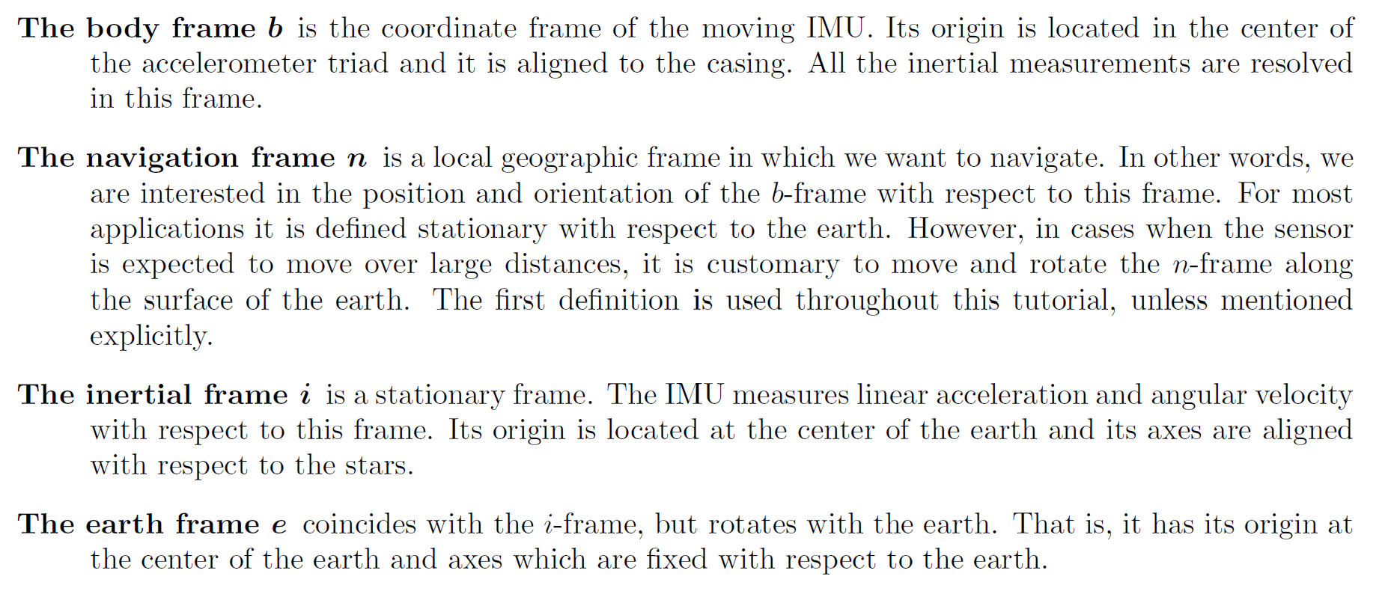
Coordinate frames - navigation frame n, body frame b

Slide 4
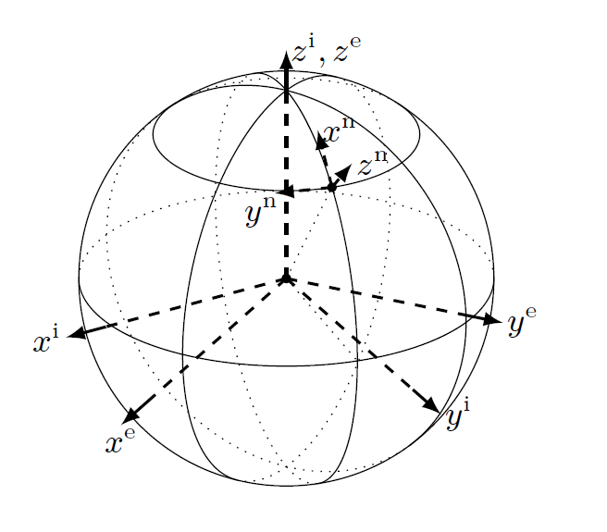
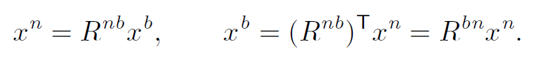
Coordinate frames – rotation matrix
An illustration of three of the coordinate frames: the n-frame at a certain location on the earth, the e-frame rotating with the earth and the i-frame
The vector x expressed in the body frame b and expressed in the navigation frame n

Slide 5
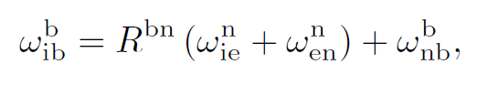
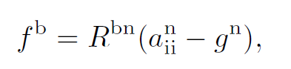
IMU sensor measurements
Axes definitions Device is equipped with three-axis accelerometer, gyroscope and vector magnetometer with mutually orthogonal axes: x axis is looking “forward”, z axis is looking “downwards”, y axis completes the right orthogonal system of axes
Gyroscope measures positive angular rates being rotated counter-clockwise (if one watches from the end of the corresponding axis) in rad/sec
Angular Velocity
Accelerometer measures the gravity force (it actually doesn’t - it can only measure active forces, and when it sits on the table it measures the force with which the table acts on the accelerometer body preventing it from falling right through the lid of the table) in m/sec^2
Specific Force
Magnetometer measures the Earth’s magnetic field vector in micro-tesla

Slide 6
IMU sensor errors
Integration of the gyroscope measurements provides information about the orientation of the sensor. After subtraction of the earth's gravity, double integration of the accelerometer measurements provides information about the sensor's position. To be able to subtract the earth's gravity, the orientation of the sensor needs to be known. Hence, estimation of the sensor's position and orientation are inherently linked when it comes to inertial sensors
The process of integrating the measurements from inertial sensors to obtain position and orientation information, is called deadreckoning
Inertial measurements are noisy and biased. Because of this, the integration steps from angular velocity to rotation and from acceleration to position introduce integration drift

Slide 7
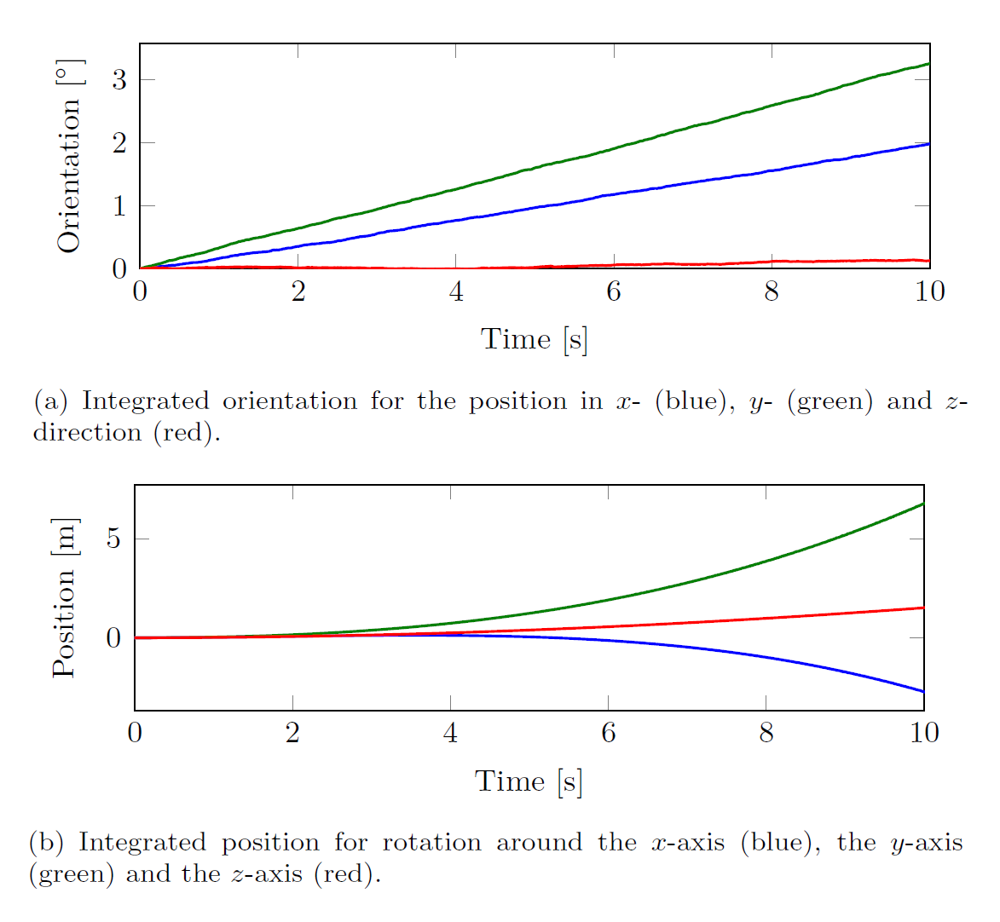
IMU sensor errors

Slide 8
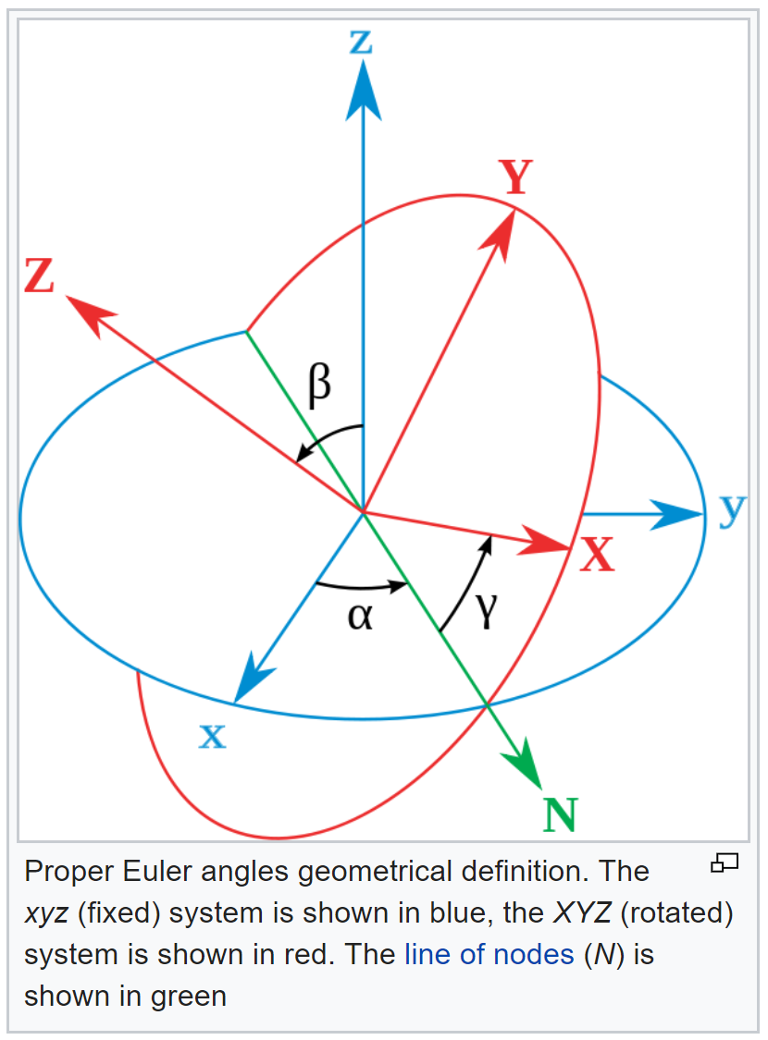
Orientation – Euler angles

Slide 9
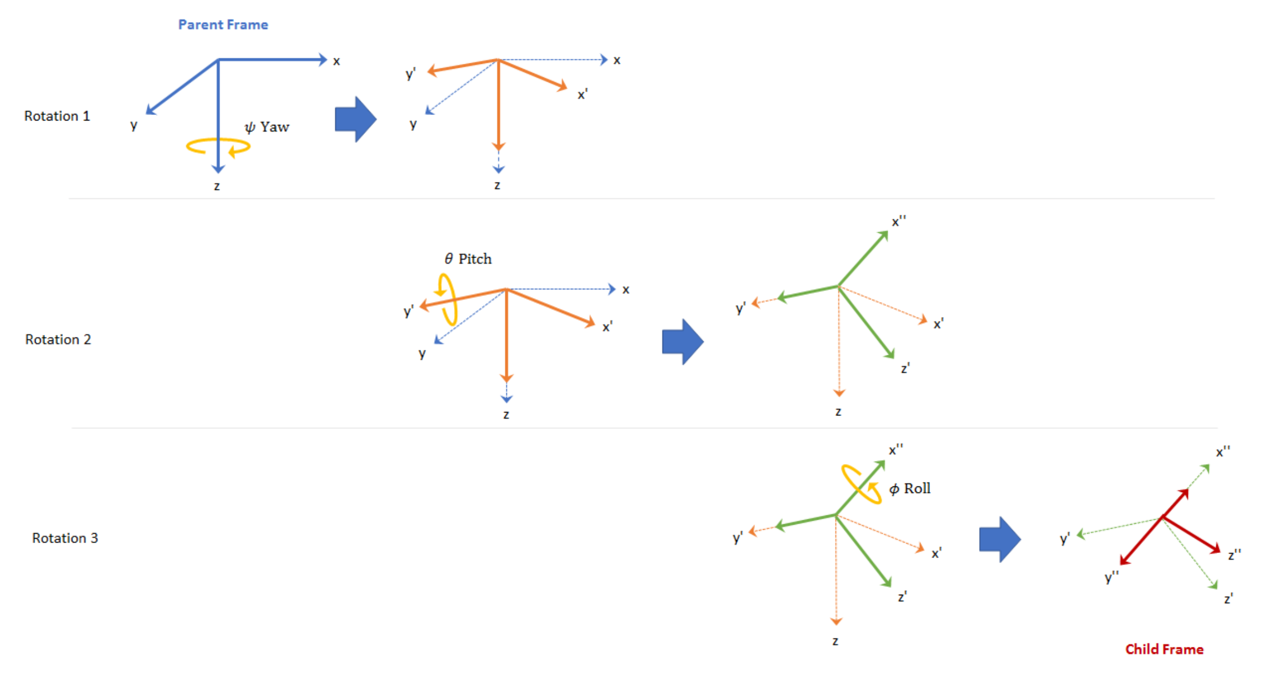
Orientation – frame rotation

Slide 10
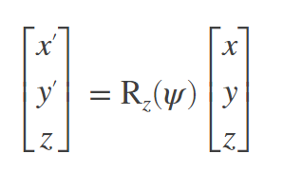
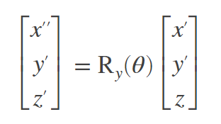
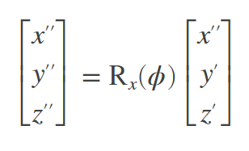
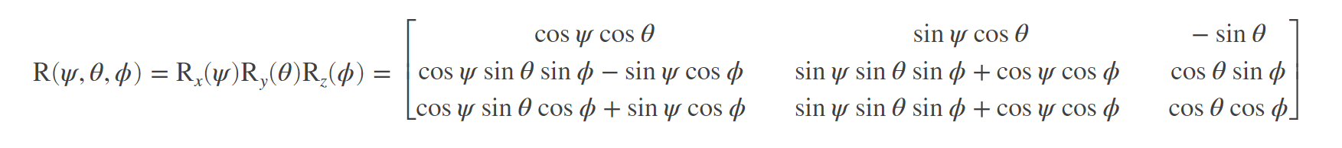
Orientation – rotation matrix
Order of rotations The standard ZYX order is used - first we rotate counter-clockwise
around the z axis, then around the new y axis and finally around the new x axis
Attitude determination Our aim is to find the attitude of the device, equipped with sensors relative to some other pre-defined frame. We call the first frame “body” frame and latter “navigation” frame. We can define the attitude of the body using two non-collinear vectors attached to it.

Slide 11
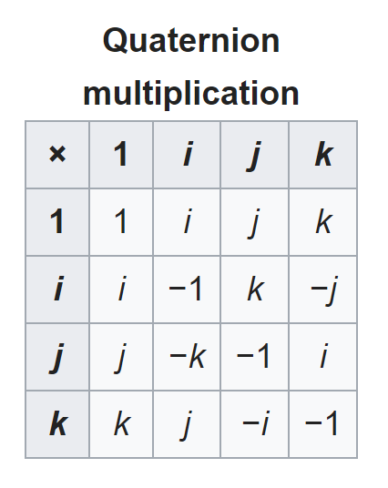
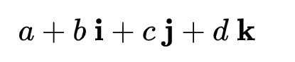
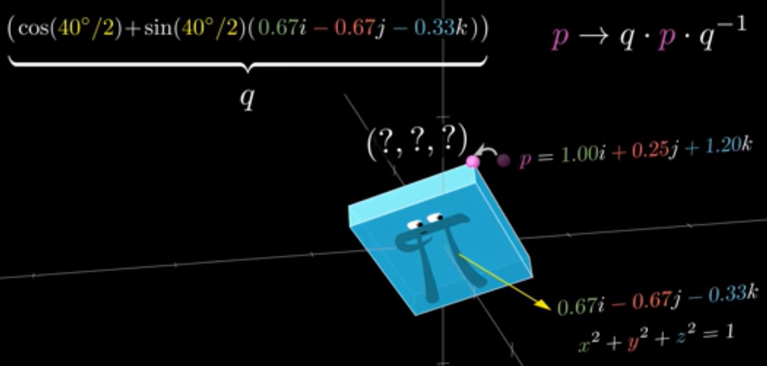
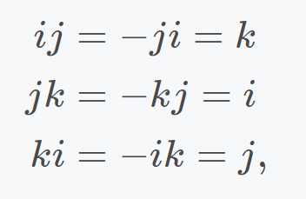
Orientation – quaternions
Quaternions are generally represented in the form
Point rotation of p about axis by 40 degrees

Slide 12
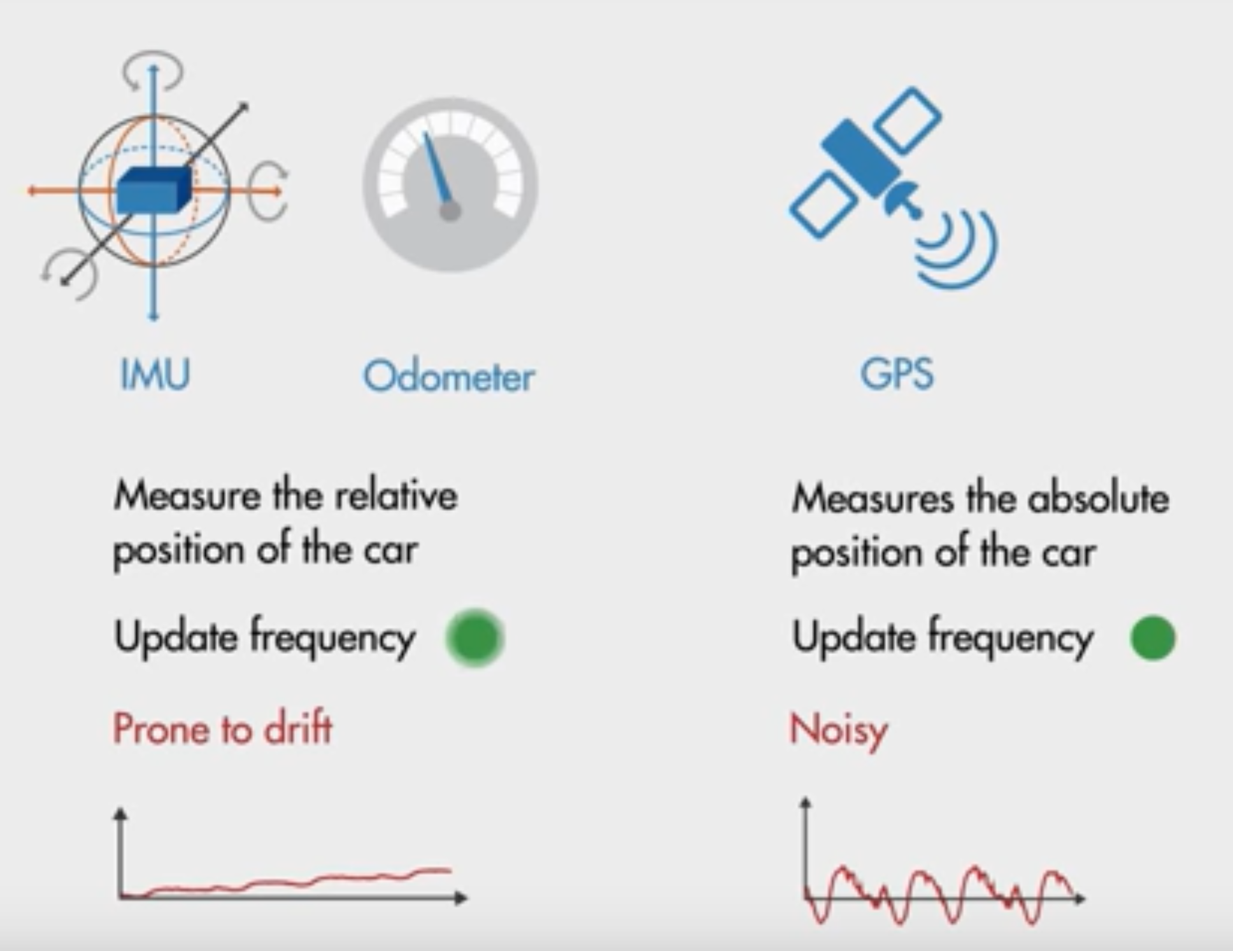
Kalman filter
Kalman filter can be used to fuse these three measurements to find the optimal position of the car

Slide 13
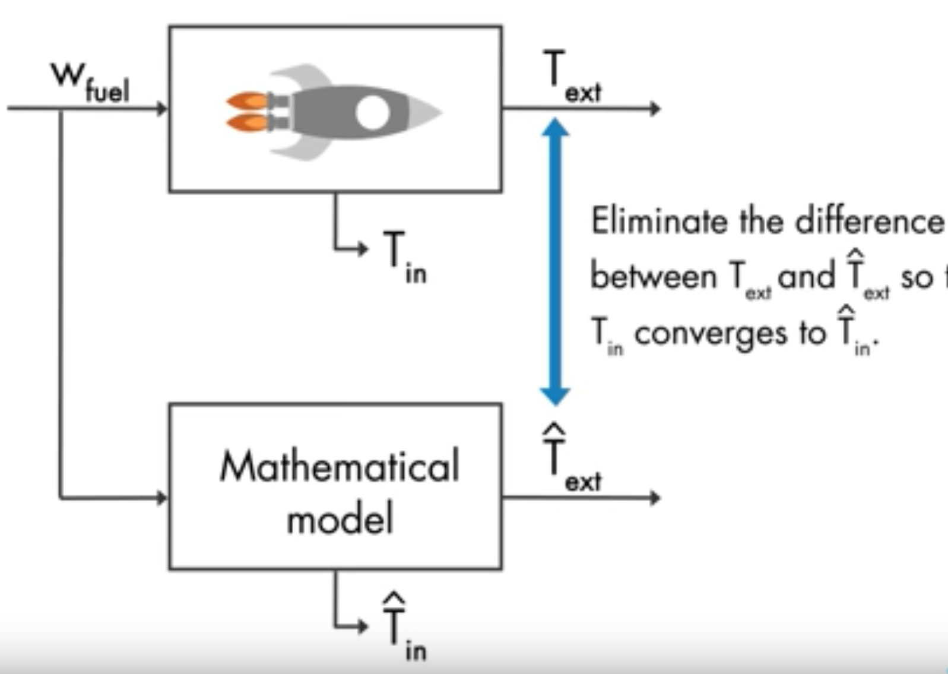
Kalman filter – state observers
We are trying to minimize the difference between the estimated and measured external temperatures

Slide 14
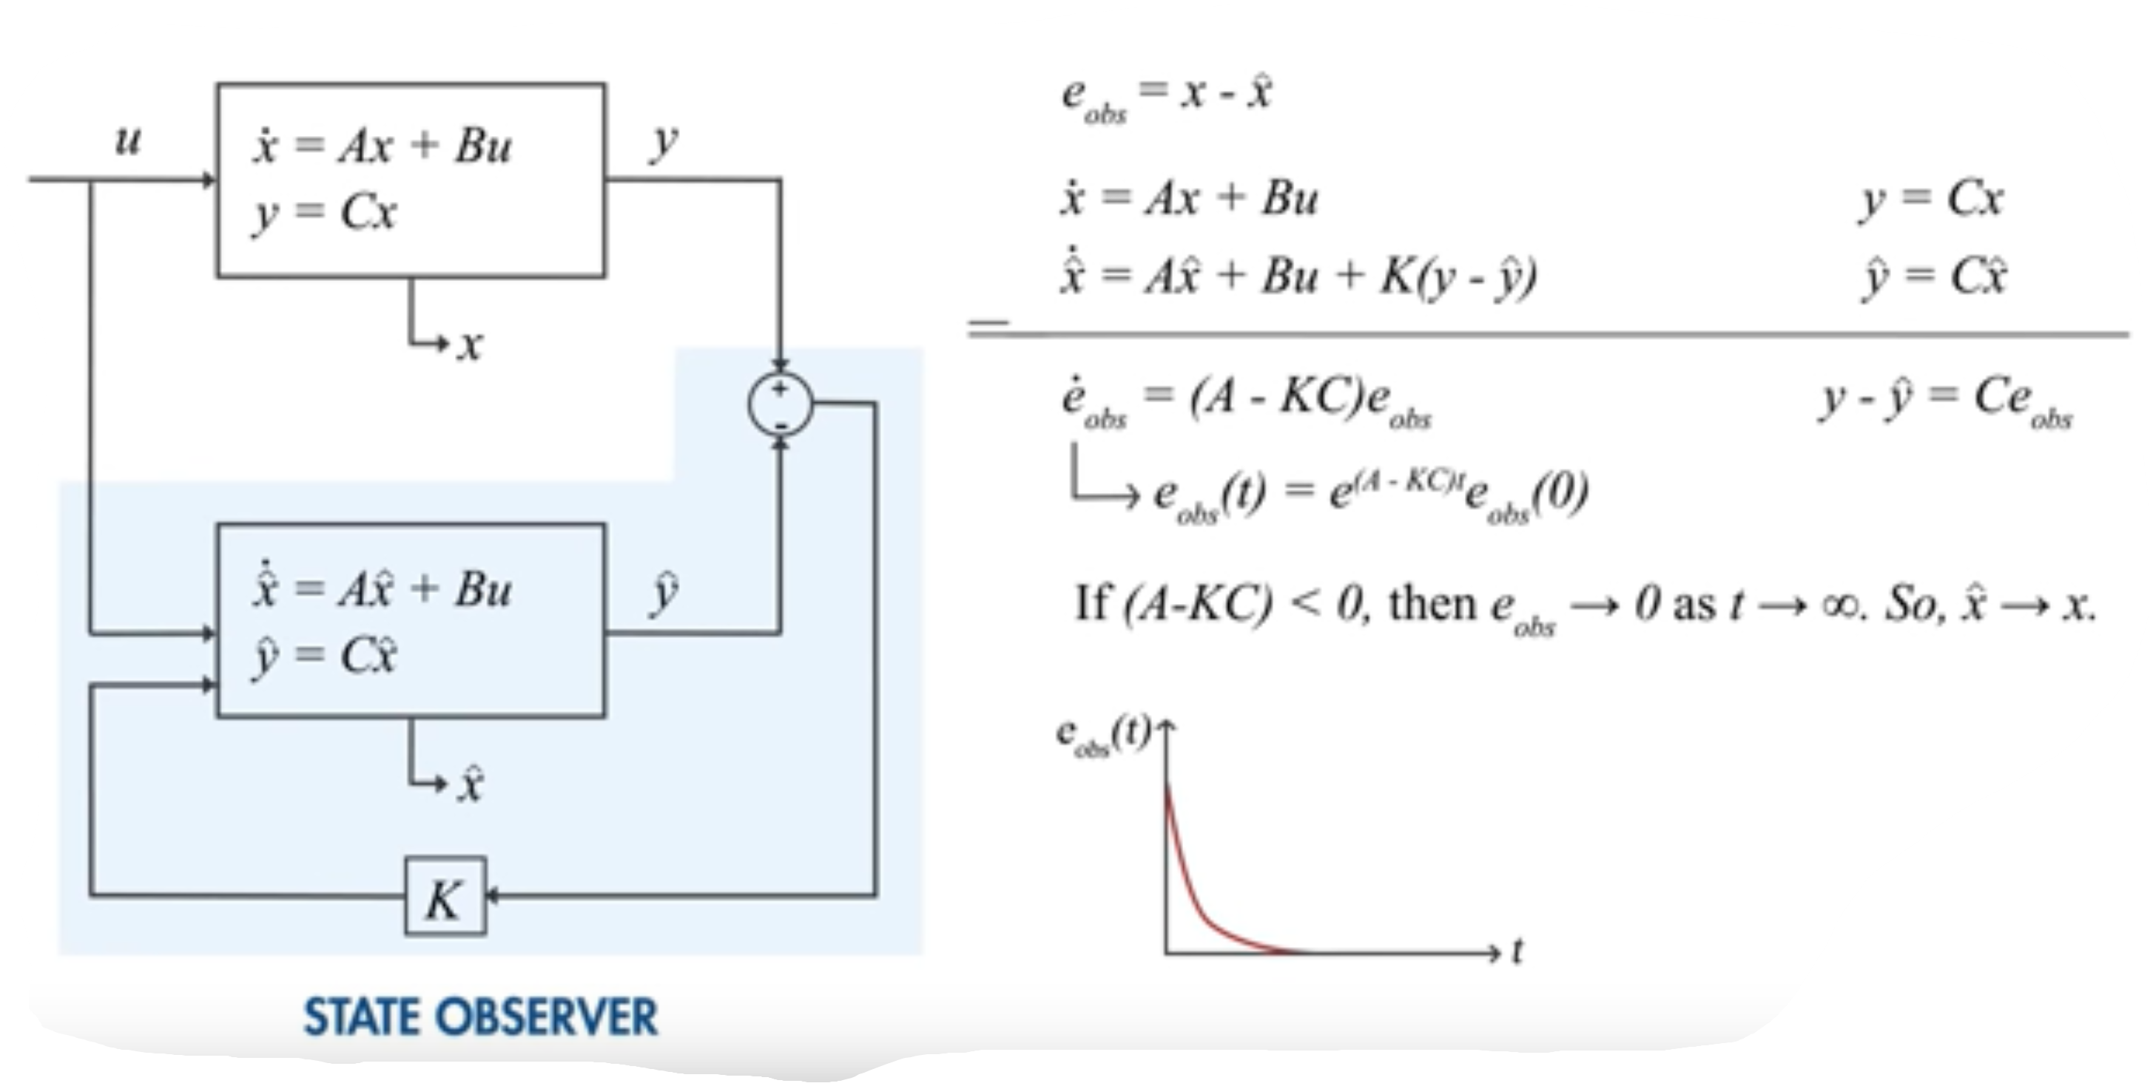
Kalman filter – state observers
State observer a feedback control system with controller gain K

Slide 15
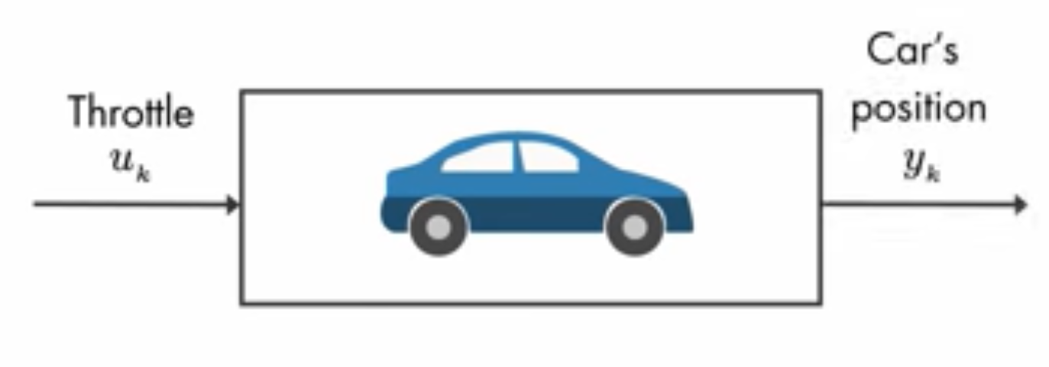
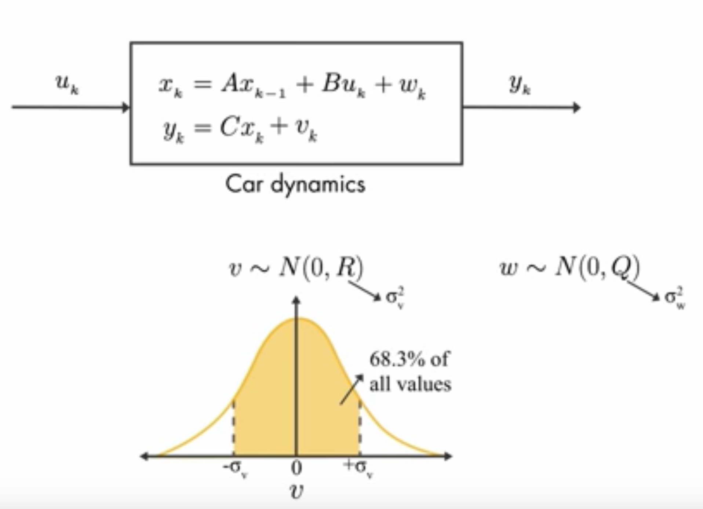
Kalman filter – optimal state estimator

Slide 16
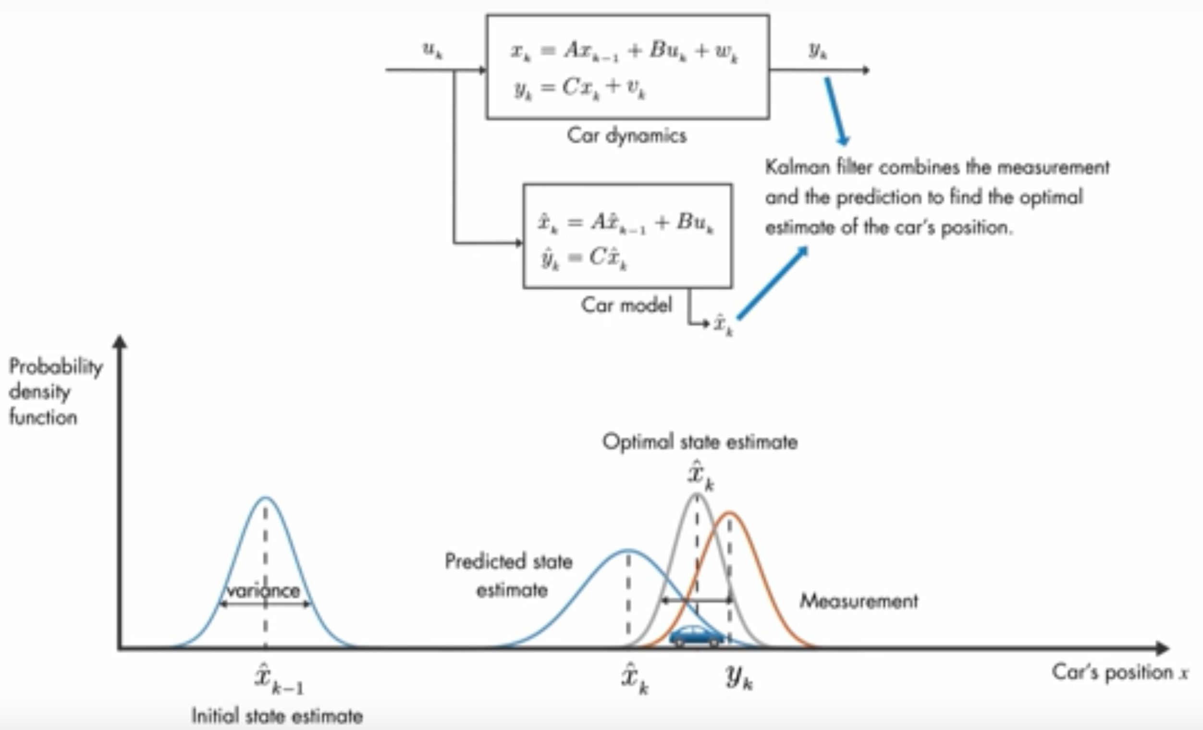
Kalman filter – optimal state estimator

Slide 17
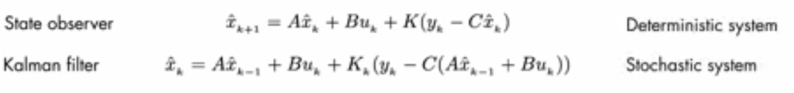
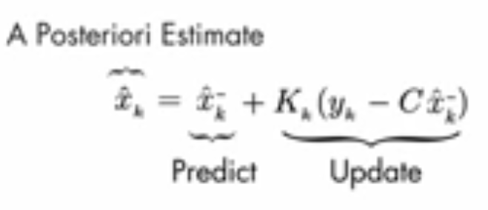
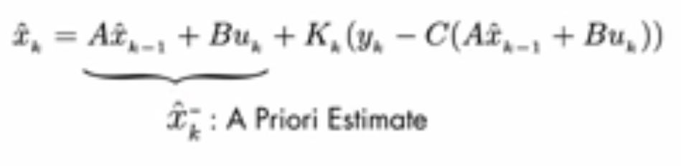
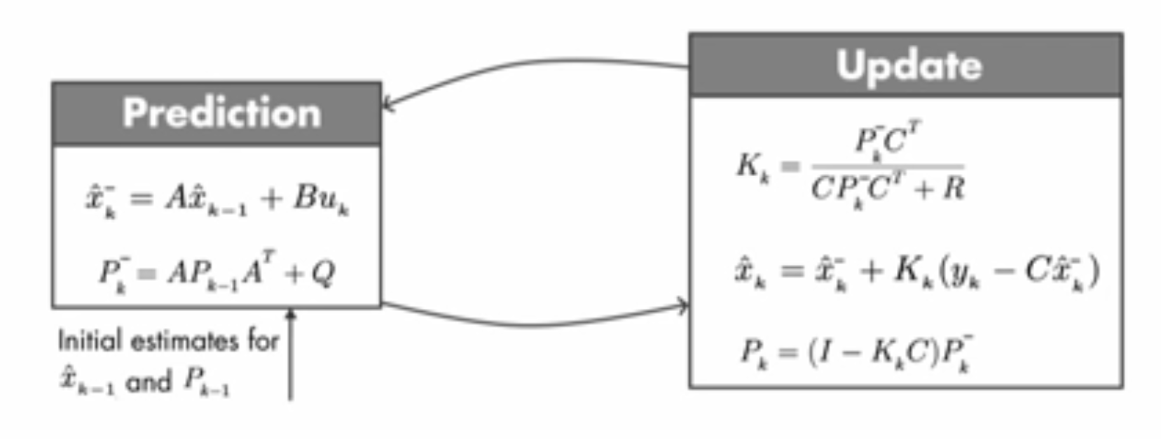
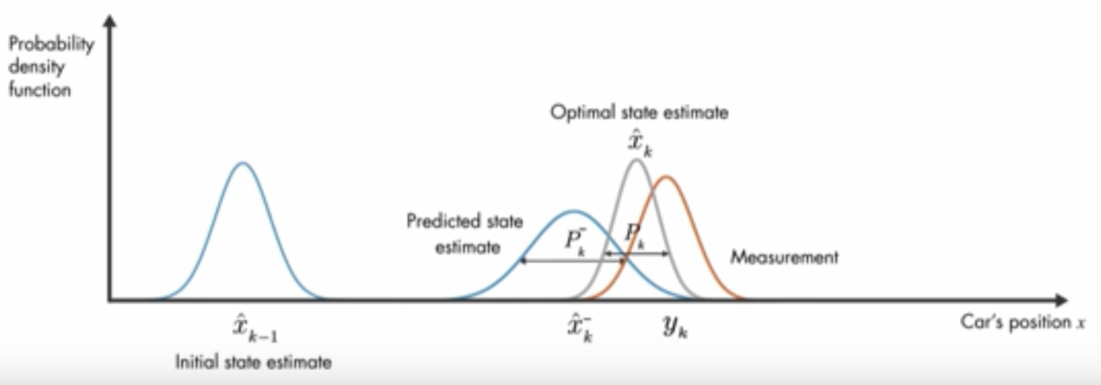
Kalman filter – optimal state estimator algorithm

Slide 18
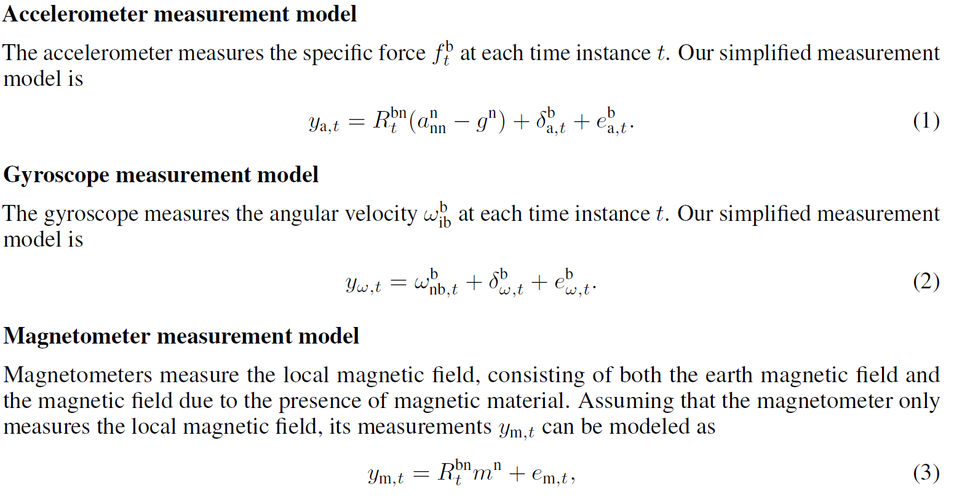
Probabilistic models – measurement

Slide 19
Probabilistic models – smoothing vs filtering
Most complexity in pose estimation lies in the nonlinear nature of the orientation and the fact that orientation can be parametrized in different ways. When all the measurement data is used in our model this is know as smoothing. This is computation intensive and assumes all measurement data is available for our estimate. The other class of estimation we will model is known as filtering. In filtering we estimate x using all measurements up to and including time t

Slide 20
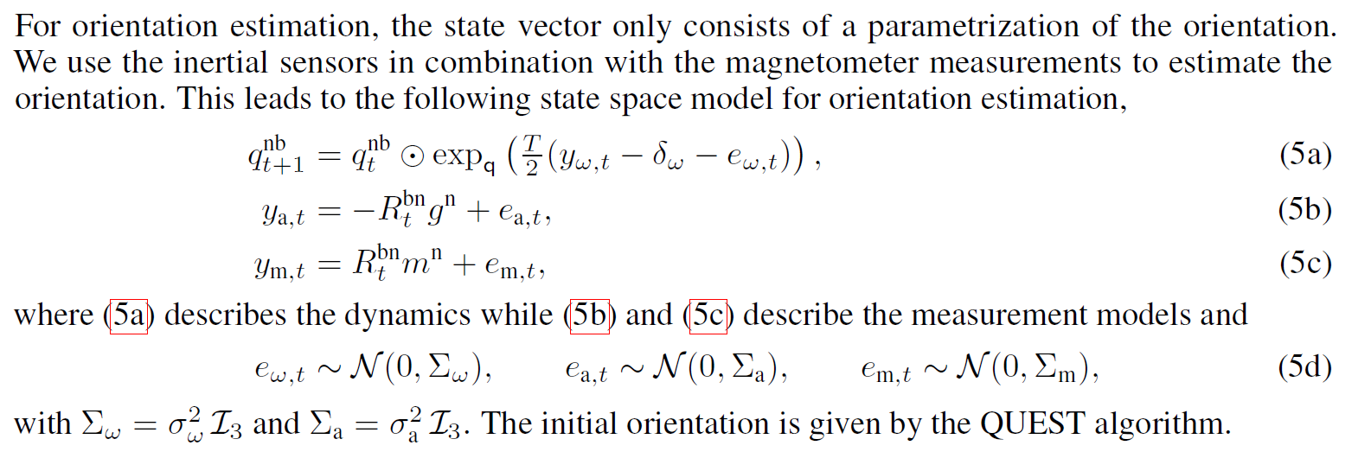
Probabilistic models – estimation
Orientation estimation

Slide 21
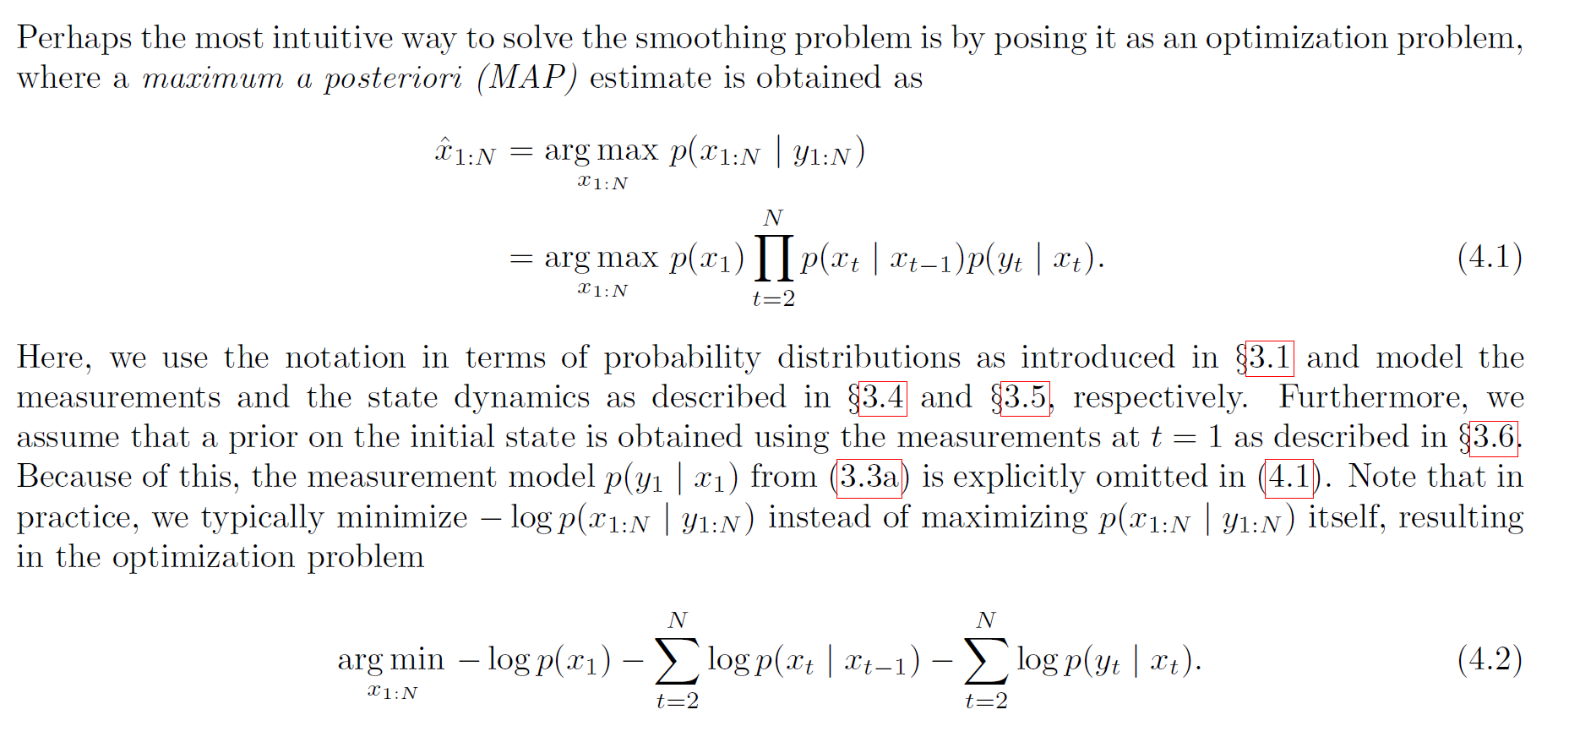
Gauss-Newton optimization
Smoothing in an optimization framework

Slide 22
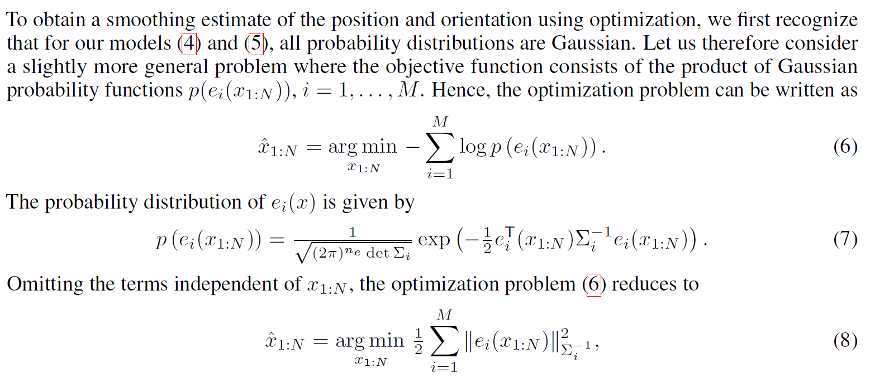
Gauss-Newton optimization
Smoothing in an optimization framework

Slide 23
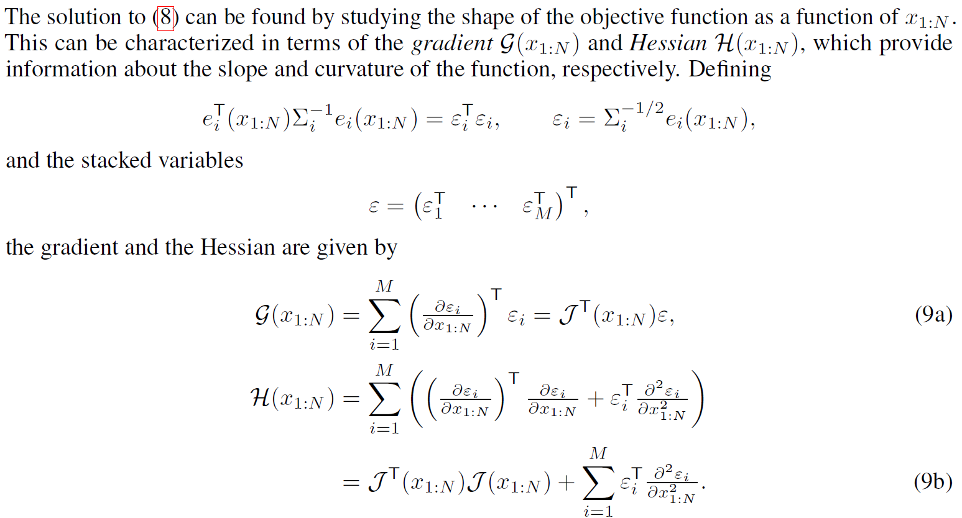
Gauss-Newton optimization
Smoothing in an optimization framework

Slide 24
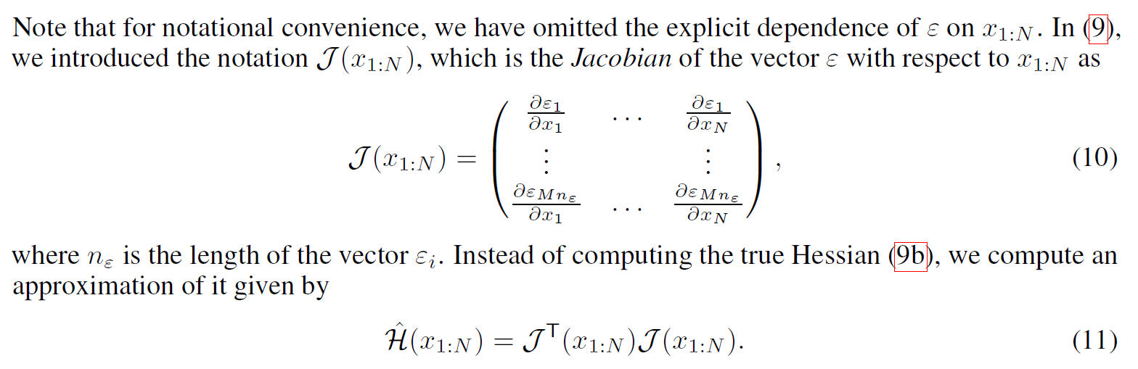
Gauss-Newton optimization
Smoothing in an optimization framework

Slide 25
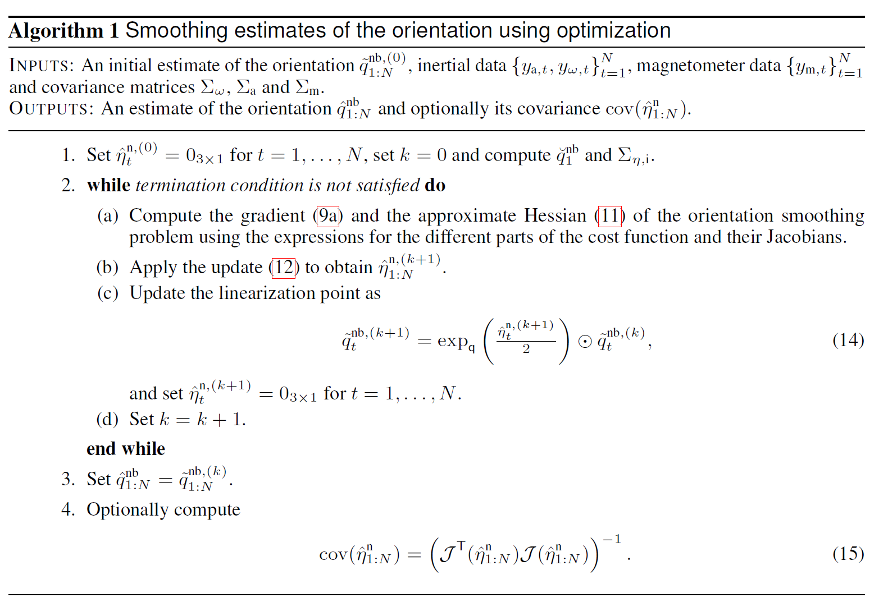
Algorithm 1 - Smoothing estimates of the orientation using optimization

Slide 26
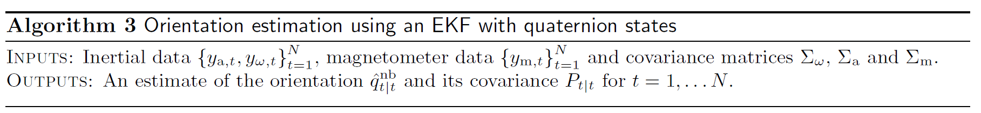
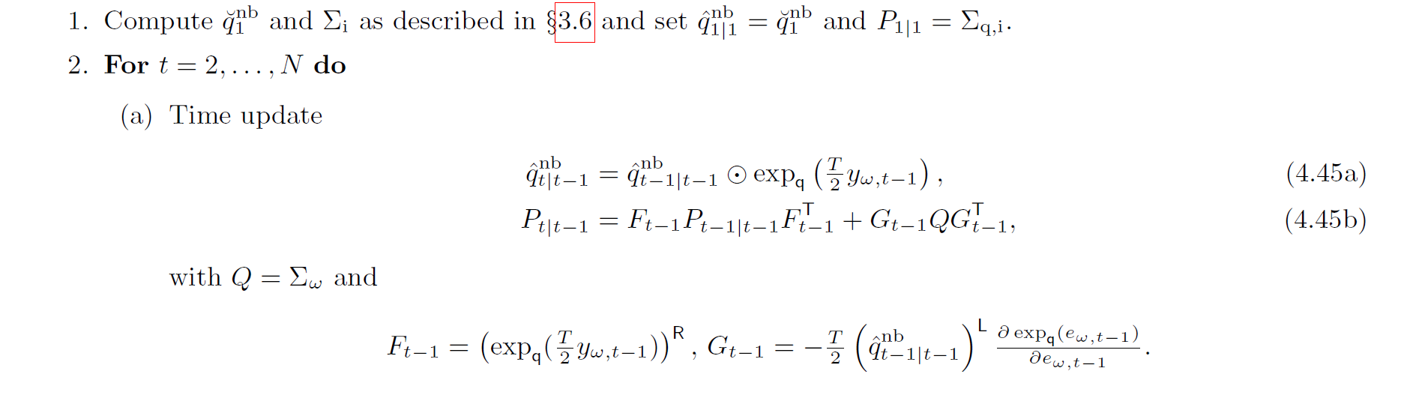
Algorithm 3 - Extended Kalman Filtering

Slide 27
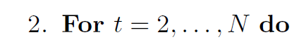
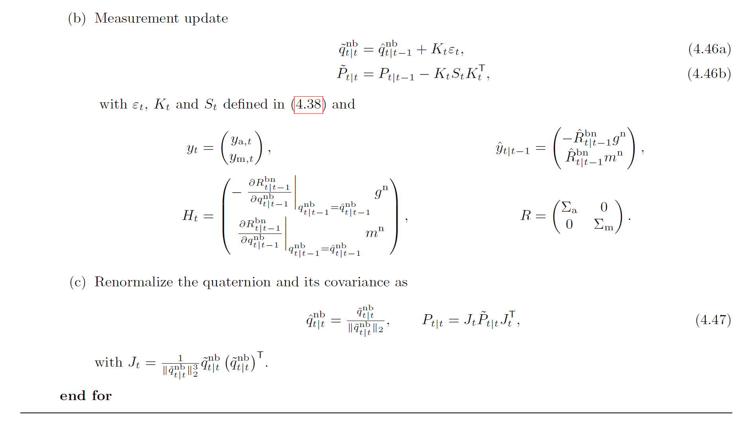
Algorithm 3 - Extended Kalman Filtering

Slide 28
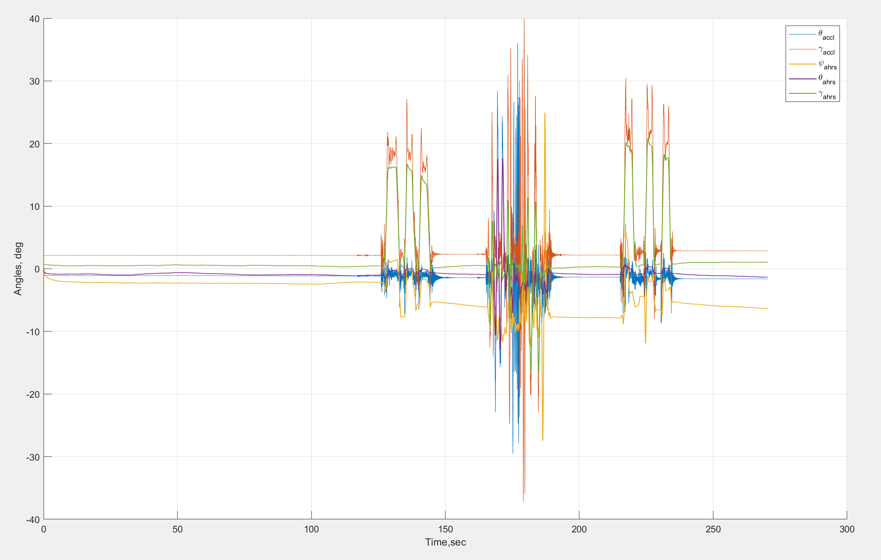
Orientation estimation results using reference data – EKF algorithm
MATLAB GyroLib reference data – microelectromechanical system (MEMS) IMU module: Fairchild’s FMT 1010
Orientation – Euler angles

Slide 29
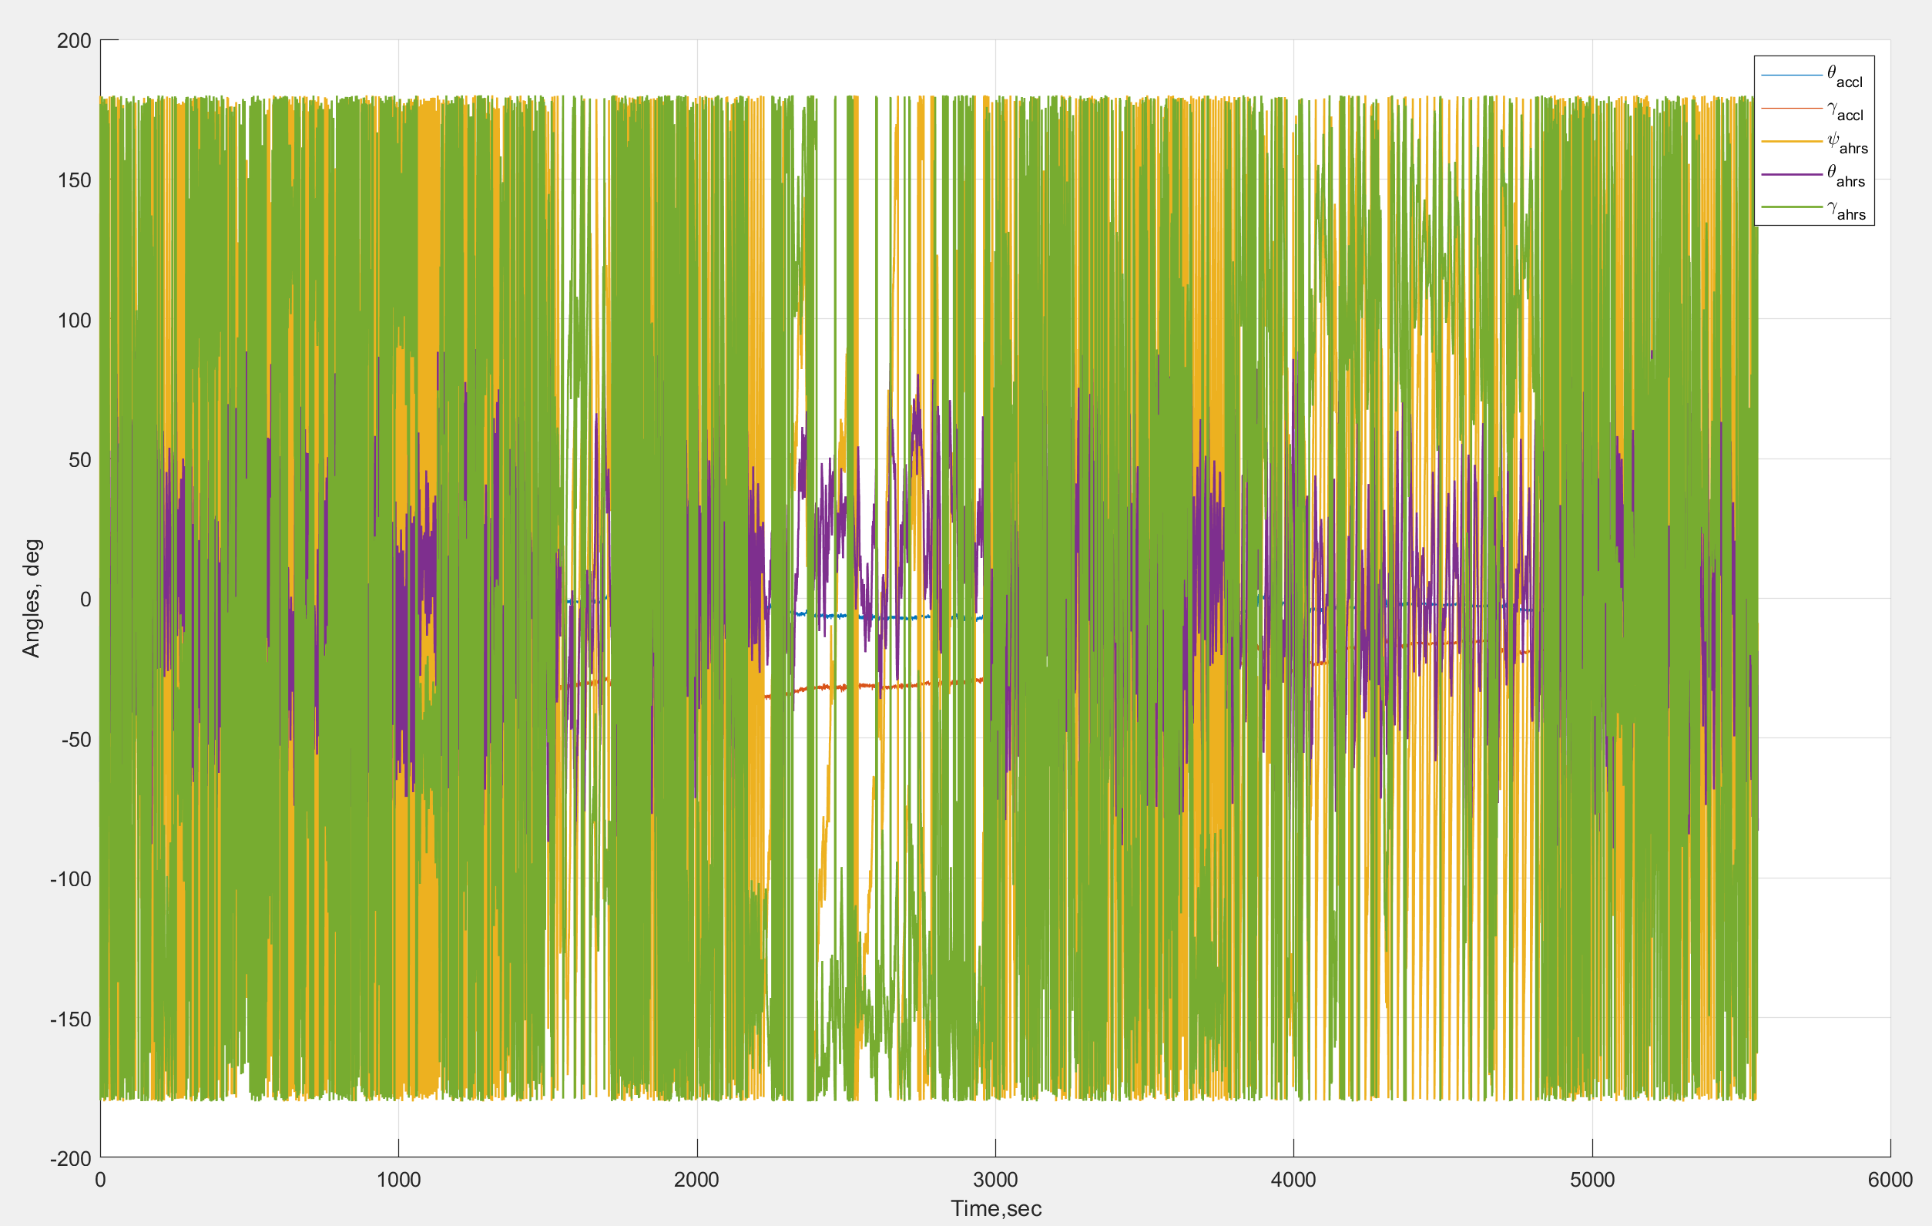
Orientation estimation results using HMOG data – EKF algorithm
HMOG user data – user Id 151985 session 2 / Reading + Sitting
Orientation – Euler angles

Slide 30
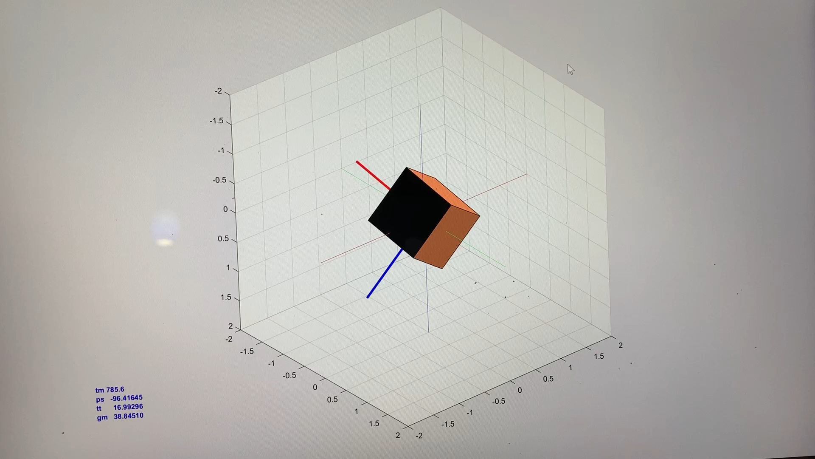
Orientation estimation results using HMOG data – EKF algorithm
HMOG user data – user Id 151985 session 2 / Reading + Sitting
Orientation – Euler angles

Slide 31
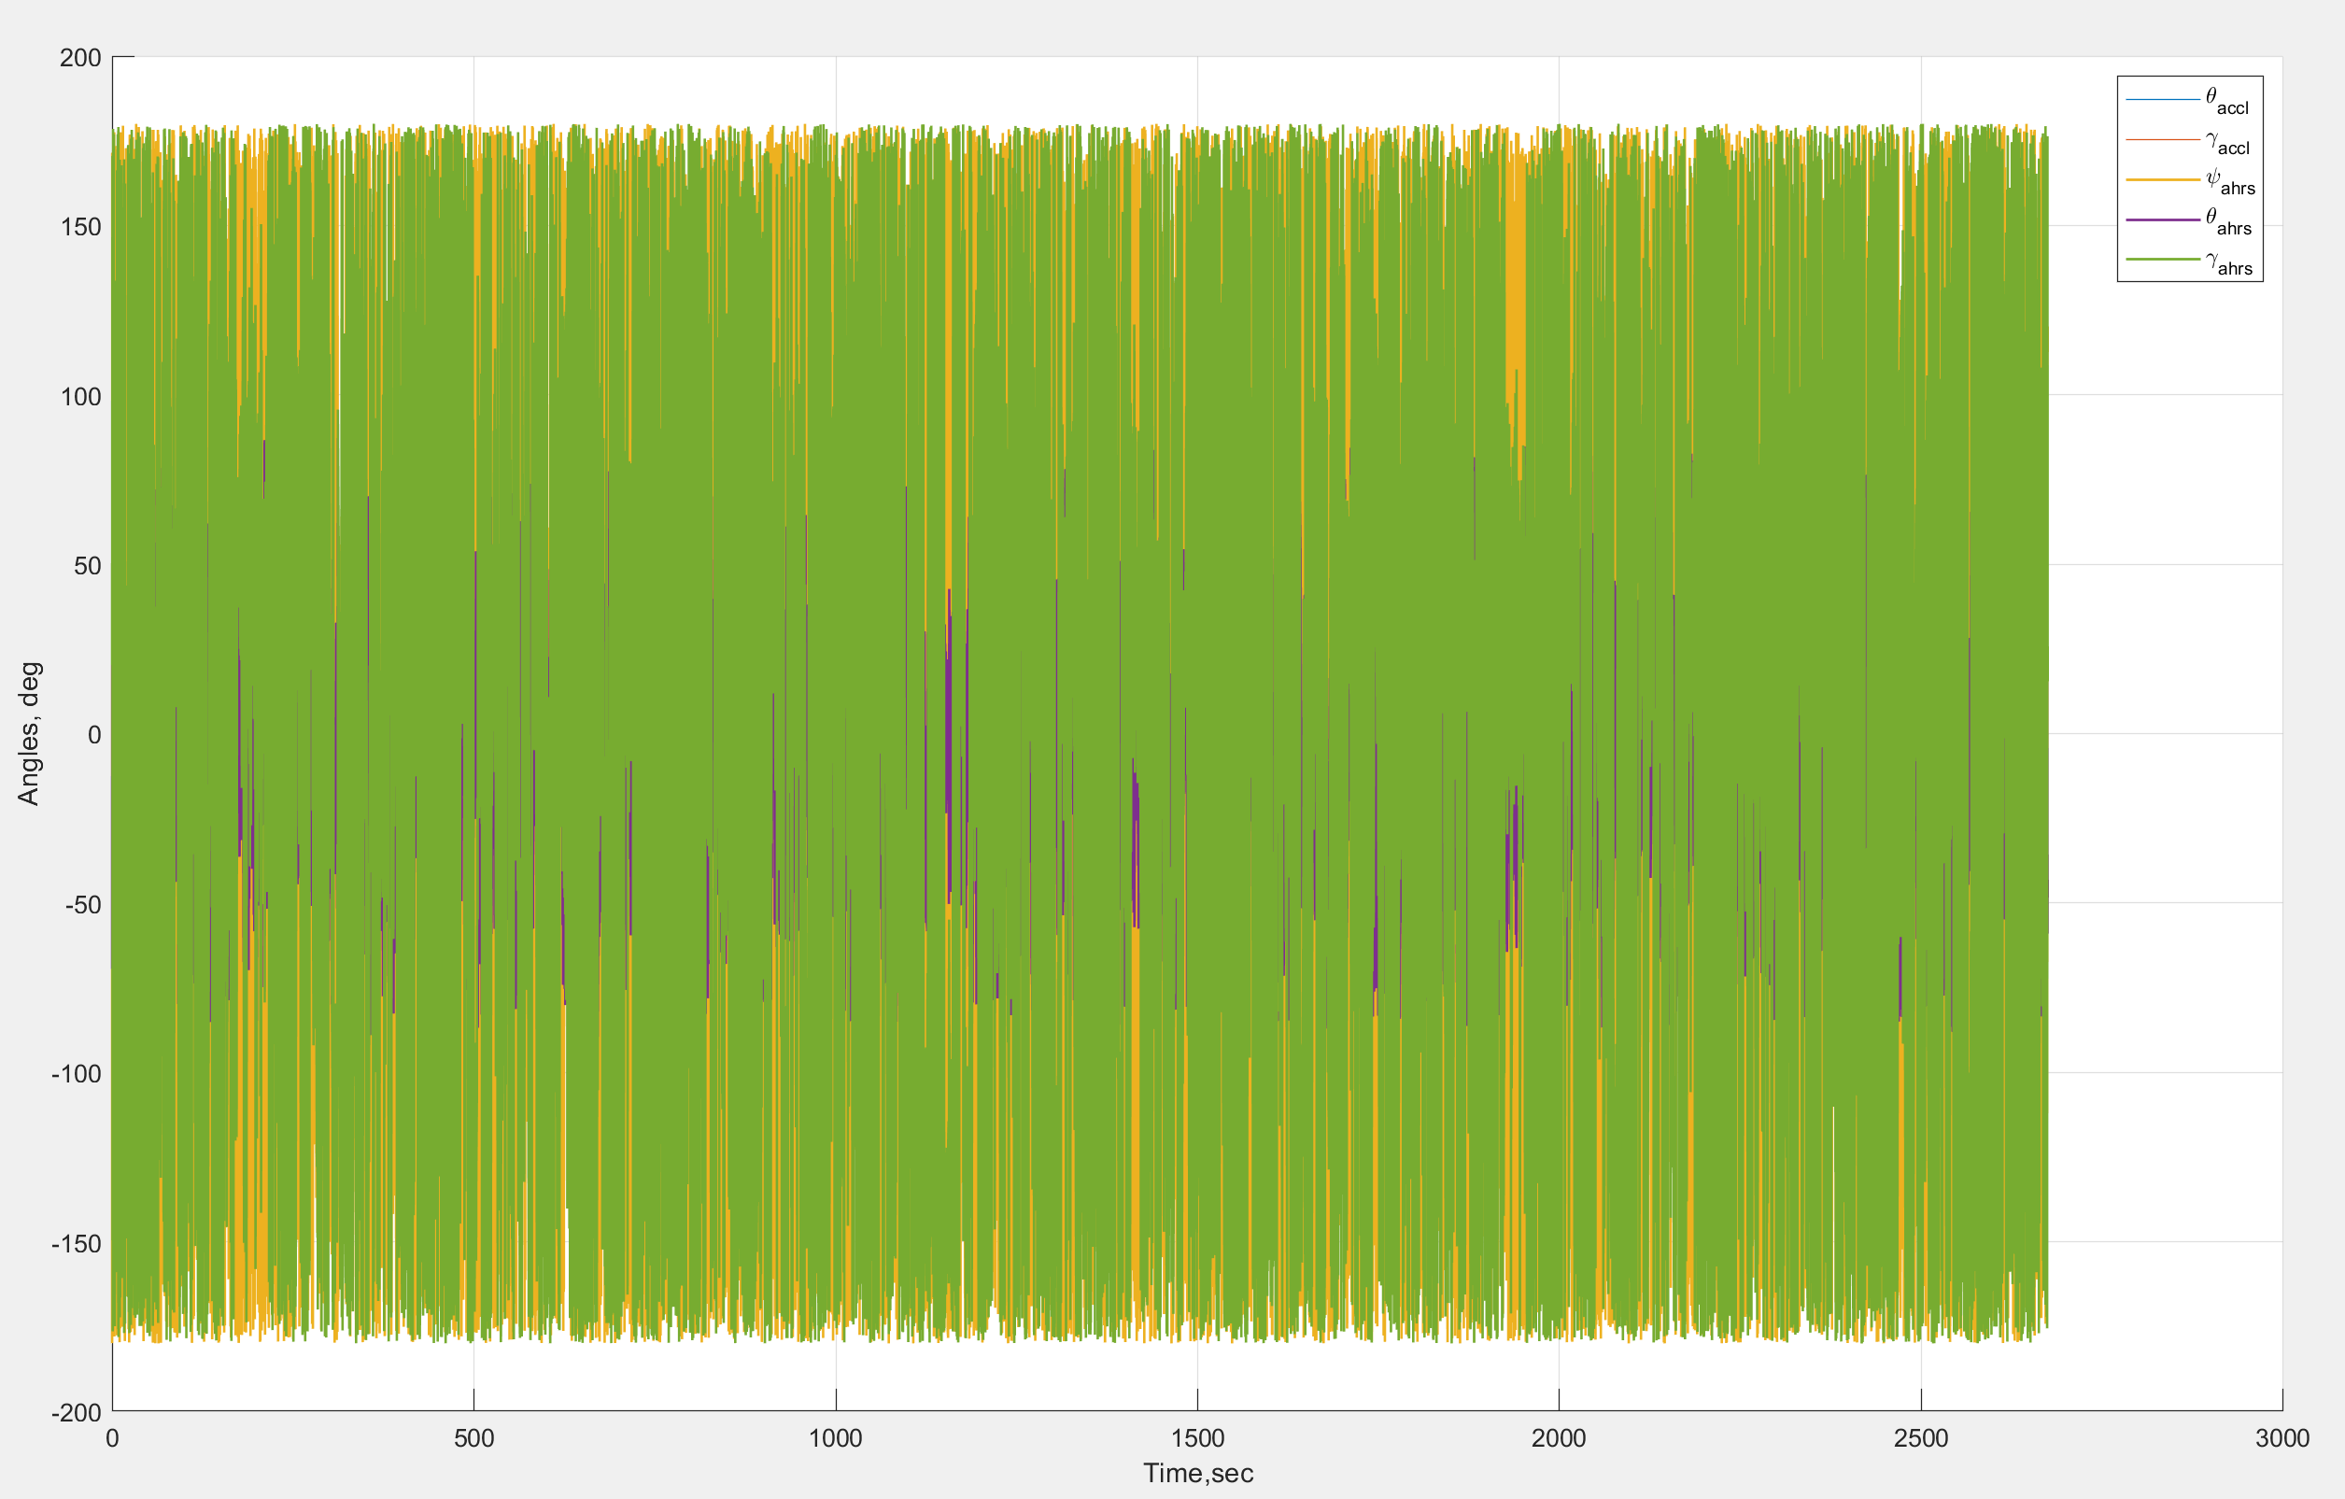
Orientation estimation results using HMOG data – EKF algorithm
HMOG user data – user Id 984799 session 16 / Reading + Walking
Orientation – Euler angles

Slide 32
References
Manon Kok, Jeroen D. Hol and Thomas B. Schon (2017), Using Inertial Sensors for Position and Orientation Estimation
SITOVÁ, Zdeňka, Jaroslav ŠEDĚNKA, Qing YANG, Ge PENG, Gang ZHOU, Paolo GASTI and Kiran BALAGANI. HMOG: New Behavioral Biometric Features for Continuous Authentication of Smartphone Users
Matlab IMU Toolbox Documentation
Matlab YouTube Channel – Kalman Filters
https://eater.net/quaternions/ - Visualizing Quaternions

